Slide 1
Introduction to the Windows 10 Universal Windows Platform Developer’s Guide to Windows 10
Andy Wigley Shen Chauhan

Slide 2





Empower every person and every organization on the planet to achieve more
Devices
Services
Devices Platform
Services Platform
Create more personal computing
Build the intelligent cloud
Reinvent productivity & business process
Notes:
Our vision: Empower every person and every organization on the planet to achieve more.
When we talk about “empower”, it starts with empowering every developer on the planet. To create experiences that span across devices and services
Today we will talk about the device platform and the cloud platform for developers
We will share three investments across this spectrum that bring awesome innovation in the hands of developers and will help make this vision become real
we as developers must put the user at the center of these experiences. Windows 10 help you reach over a billion Windows users with more personal computing experiences only possible on Windows

Slide 3
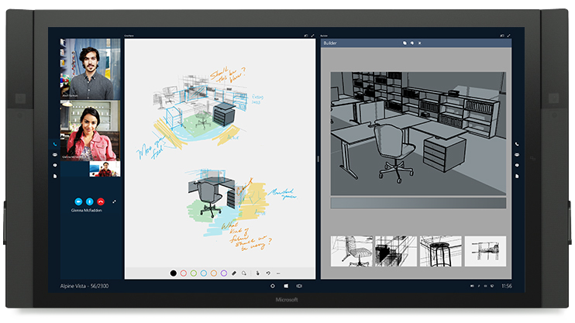
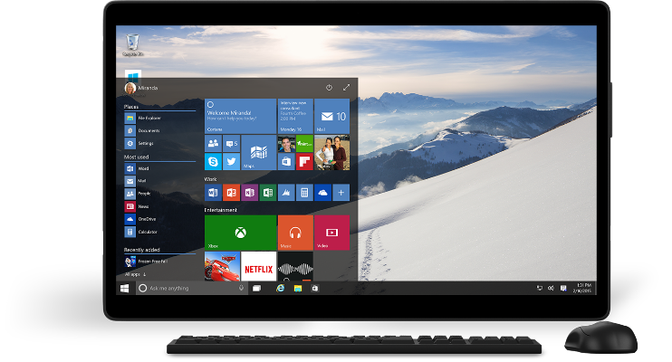
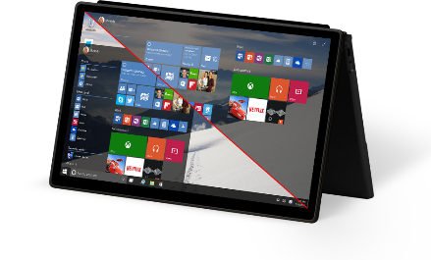
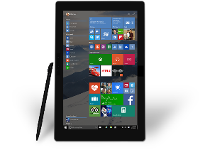
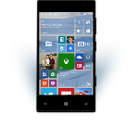
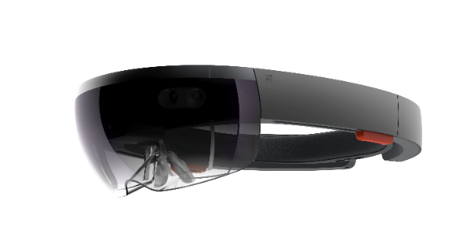
Windows 10 opportunity
Large addressable market
Smart Engagement
One Store
One developer platform
Notes:
I want to start with the device platform and the world of opportunity that Windows 10 opens .
(stop here)
We expect to have over 1 billion users pick up the free upgrade in the coming year, from Windows Phone 8, Windows 7 and 8.x, and across Xbox. And Windows apps can go onto IoT and wearable devices
We make it easier to drive engagement with your users. Windows provides a rich pallet on which you can connect with your users on a regular basis – yielding more launches and longer usage.
We now have One Store for consumer, business and education with unified dev center and app policies
One distribution channel for consumers and developers – providing a single, safe channel for doing commerce
Universal apps run on every Windows 10 device. One developer platform on which Windows experiences are built, 1st party and 3rd party alike

Slide 4
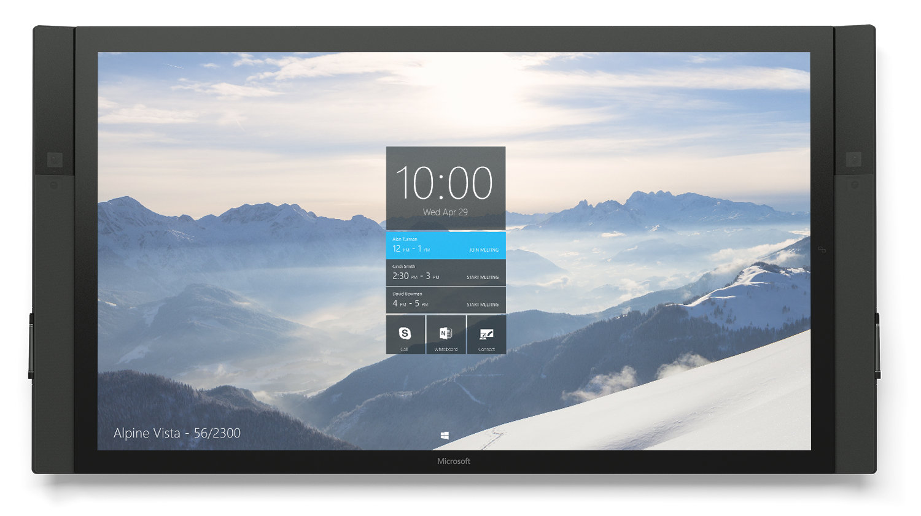
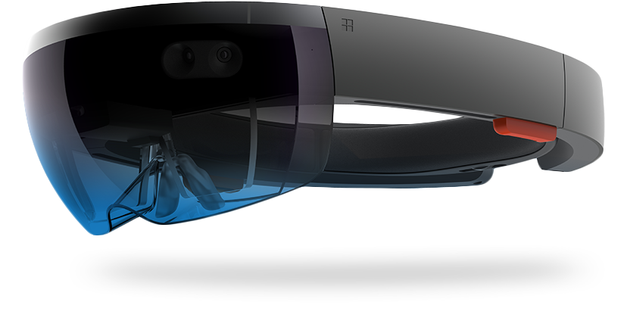
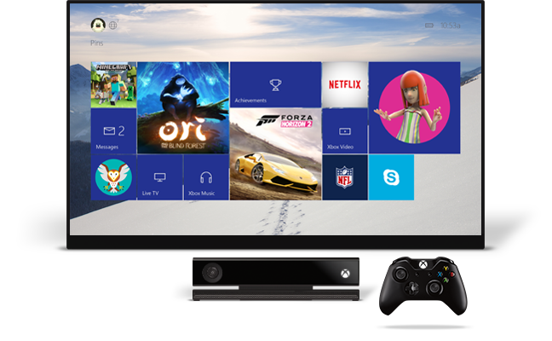
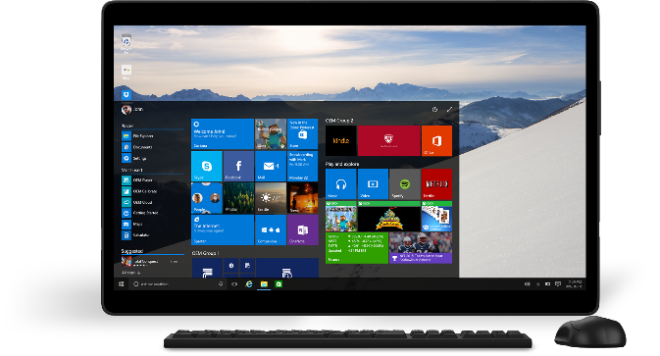
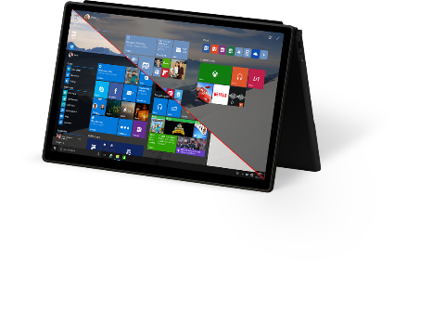
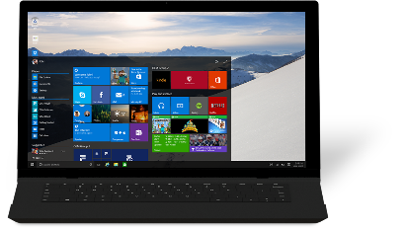
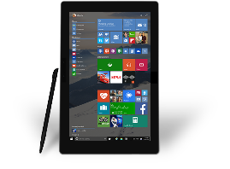



1 Billion devices
Free upgrade for the first year
Notes:
With Windows 10 we empower developers to reach their windows customers wherever they are and on whatever device they happen to be using.
They can now build one app that runs on everything from tiny IoT devices like sensors, to mobile phones and phablets. Productivity devices like the Desktop PCs and 2-in-1s. New and exciting hardware like the HoloLens. Living room devices like the Xbox. Or even the new Surface Hub in a meeting room.
<click>
To make this ALL worthwhile for developers, we know we need to get Windows TEN to be BROADLY adopted In fact, our GOAL is that within TWO to THREE years of Windows 10’s release, there will be ONE BILLION devices running Windows 10
<<CLICK>>
So we made Windows 10 available as a FREE upgrade for first year – EASY for consumers & businesses to move QUICKLY

Slide 5
Introducing the UWP

Slide 6

The convergence journey
Xbox 360
Xbox One
Unified core and app platform
Converged
OS kernel
Windows 8.1
Windows 8
Converged
app model
Windows 10
Windows Phone 8.1
Windows Phone 8
Easy for users to get & stay current
Windows Phone 7.5
Windows on Devices
Notes:
TODO: add some talking points why YOU as dev should care about Win10, mention the servicing to get everybody on the latest version
Platform convergence has been a journey which ends today with Windows 10
We started by bringing Internet Explorer to Windows Phone 7.5 and even Xbox 360. With the release of Windows 8 we laid the foundation with the windows kernel, drivers etc. Windows Phone 8 took advantage of this. Xbox One was built on top of Windows 8 and even used the same runtime so developer could write apps in HTML/WinJS the same framework as available on Windows 8.
With the release of Windows Phone 8.1 the runtimes from Windows 8.1 and phone came together as well. Over 90% API convergence and things like Windows Notification Services, sharing contracts, live tiles etc started to come together.
Our endpoint Threshold brings together everything, the foundation is the same, kernel, drivers etc. The application platform is the same and we will go into a little bit more detail later in this presentation.
Background data:
9/15/11 Windows Phone 7.5
10/26/12 Windows 8
10/29/12 Windows Phone 8
10/18/13 Windows 8.1
11/22/13 Xbox One
4/8/14 Windows 8.1 Update
3/26/14 Windows Phone 8.1

Slide 7
Windows Core
The refactored common core
One hardware platform
Universal hardware driver
Standard network and I/O
Desktop SKU
Mobile SKU
Xbox SKU
…
Windows Core
Desktop
Hardware
Phone
Hardware
Xbox
Hardware
…

Slide 8
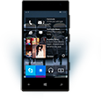

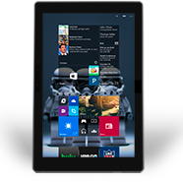
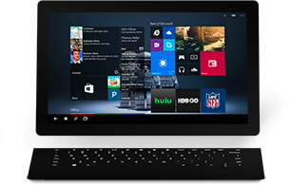

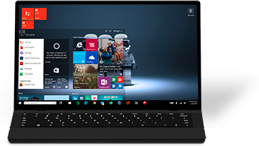

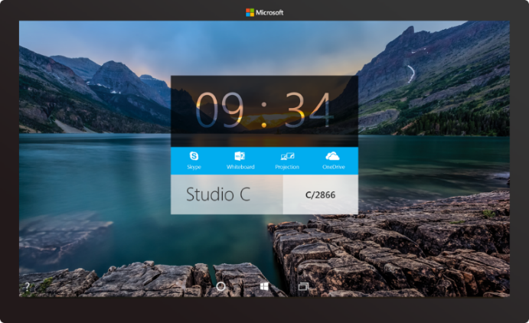





2-in-1s (Tablet or Laptop)
Classic Laptop
Desktops & All-in-Ones
Phone
Phablet
Small Tablet
Large Tablet
Windows 10
Surface Hub
Xbox
Holographic
IoT

Slide 9

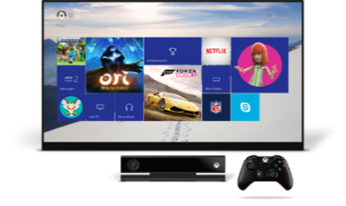
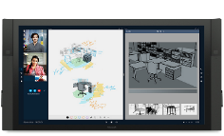

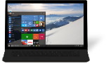

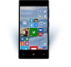
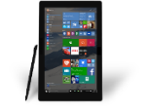
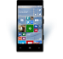
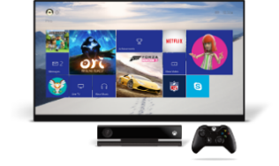










PC
XBox
Mobile
Surface Hub
Devices +IoT
HoloLens
Universal Apps
Multiple device families
Adaptive User Interface
Reuse Existing Code
Natural User Inputs
One Store + One Dev Center
One SDK + Tooling
One Universal Windows Platform

Slide 10
WPF
WF
MFC
XAML
HTML
Bridging technologies
Obj.C
iOS
Java
Android
Web
hosted
Win32
desktop
DirectX
.Net
languages
C++
.Net
languages
C++
& CX
WWA
.Net
runtime
Universal Windows Platform
Windows 10
operating system

Slide 11
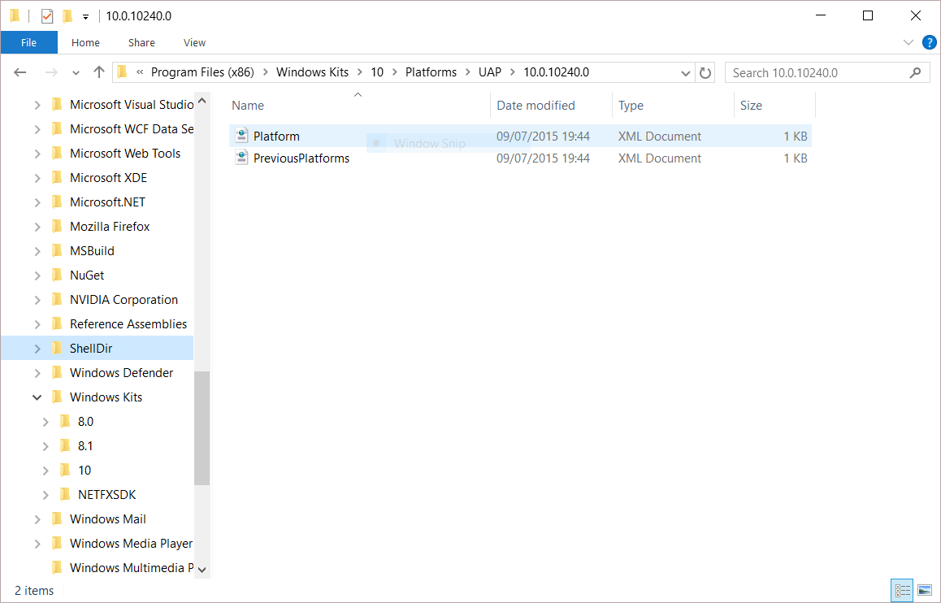
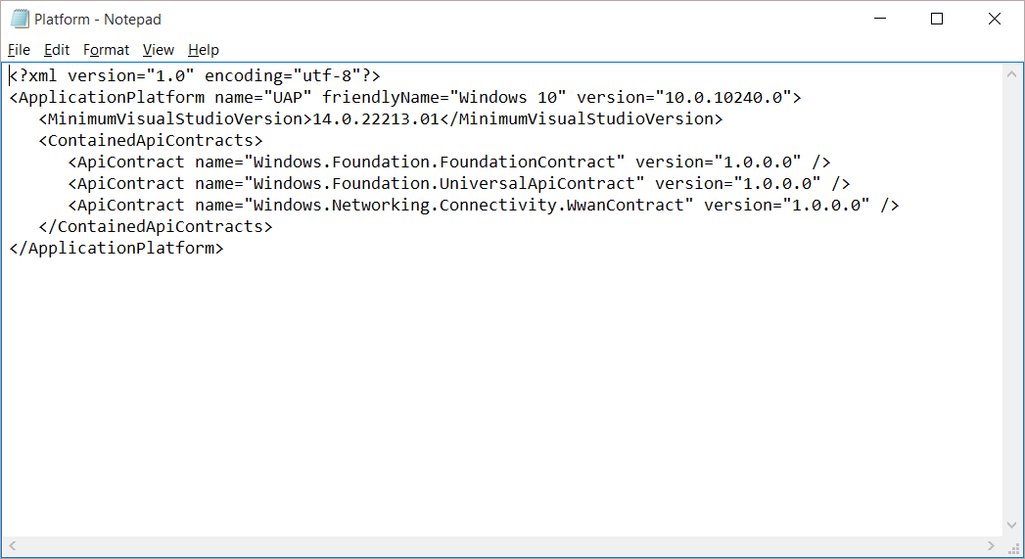
Universal Windows Platform
A single API surface
A guaranteed API surface
The same on all devices
Universal Windows Platform
Windows Core
Desktop
Device
Phone
Device
Xbox
Device

Slide 12
A whole lot of APIs…
Storage
DirectX 12
Speech and Cortana
Networking
NFC and Bluetooth
Holographic
Audio and Video
Appointments/Calendar
Authentication Broker
Background Transfer
Maps and Location
Sensors: Accelerometer, light, magnet …
Tiles and Notifications
App to App and App Services
Inking
XAML
Background Tasks
Data Roaming
Data.XML
Media Casting
Many, many more….
Notes:
And many, many more great features that you’ll learn about in this Jump Start.

Slide 13
Apps don't target Windows 10, apps target the UWP

Slide 14
<Dependencies>
<TargetDeviceFamily
Name="Windows.Universal"
MinVersion="10.0.10240.0"
MaxVersionTested="10.5.0.0"/>
</Dependencies>

Slide 15
The Universal Windows Platform can update at its own cadence

Slide 16
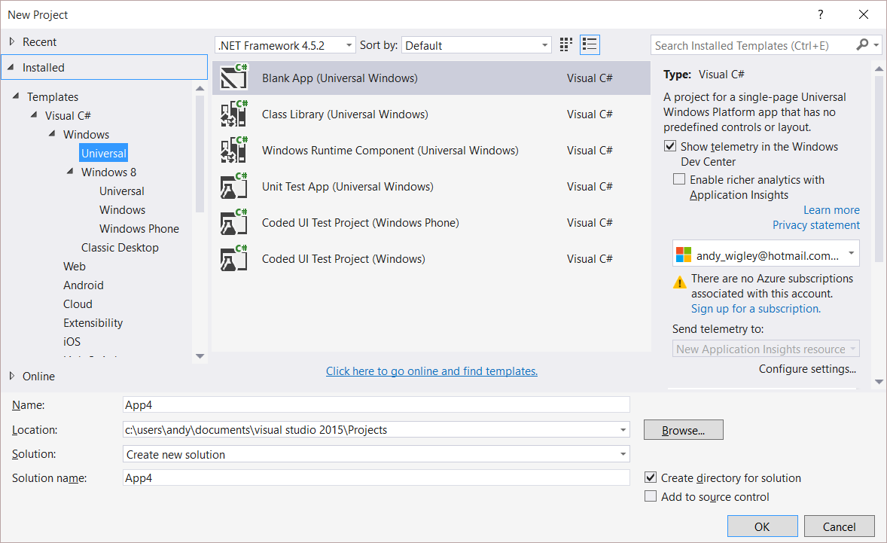
Windows app
A single binary
Running on any device
Testing for capabilities
Adjusting to devices
Windows App
Universal Windows Platform
Windows Core
Desktop
Device
Phone
Device
Xbox
Device

Slide 17
Demo: Hello devices

Slide 18

Universal Windows Platform
One Operating System
One Windows core for all devices
One App Platform
Apps run across every family
One Dev Center
Single submission flow and dashboard
One Store
Global reach, local monetization Consumers, Business & Education

Slide 19
One Windows
Desktop SKU
Mobile SKU
Xbox SKU
IoT SKU
IoT headless SKU
Surface Hub SKU
Holographic SKU
PC
2 in 1
Tablet
Phablet
Phone
Xbox
Band
Raspberry Pi
Surface Hub
HoloLens
Home Automation

Slide 20
Each family offers its own shell and adds features to those it inherits

Slide 21
Adaptive UI

Slide 22
Adaptive design
Responsive design
Flexible layout responds to small changes
Many controls handle basic responsiveness
Adaptive design
Smart layout adjusts to large changes
Features like visual states aid in this design
Tailored design
A device-specific app can simplify design
Some devices have unique design languages

Slide 23
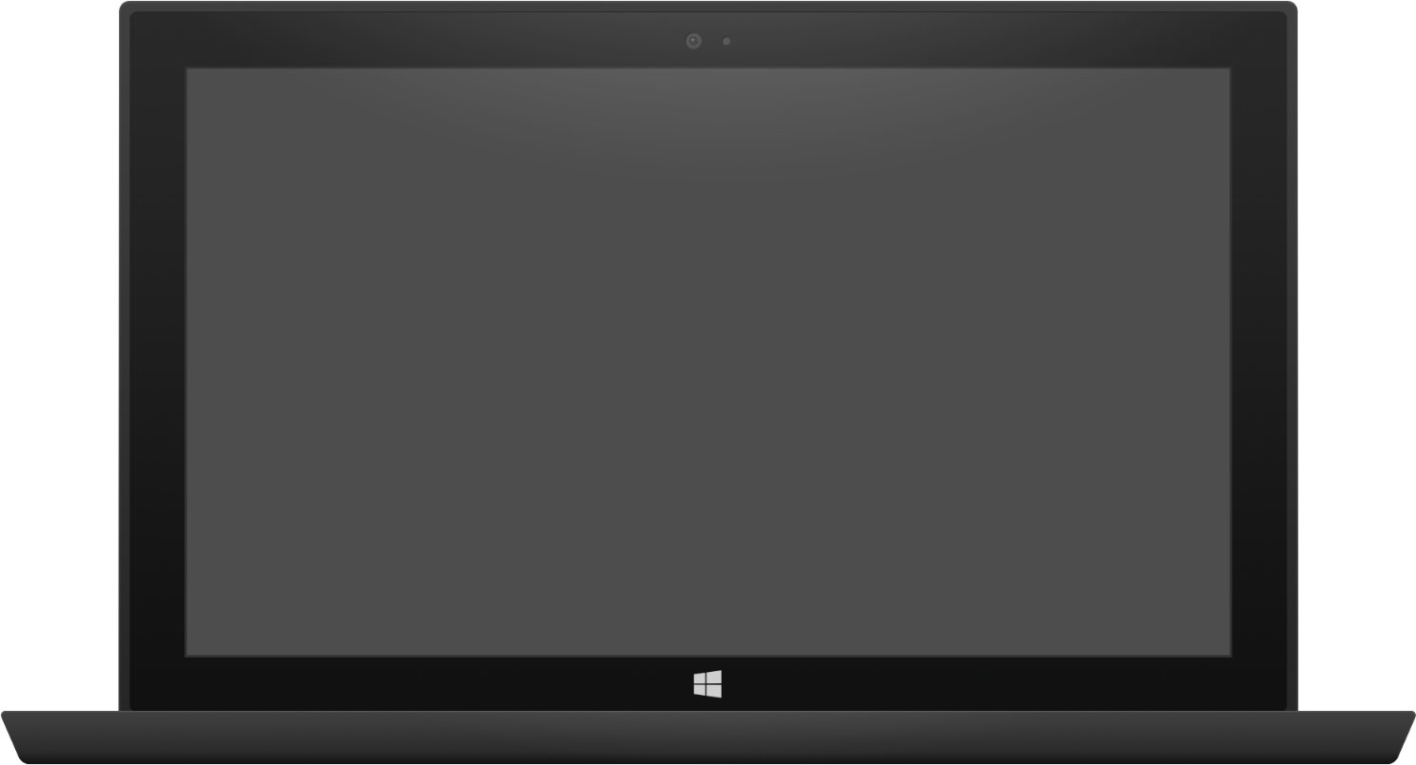

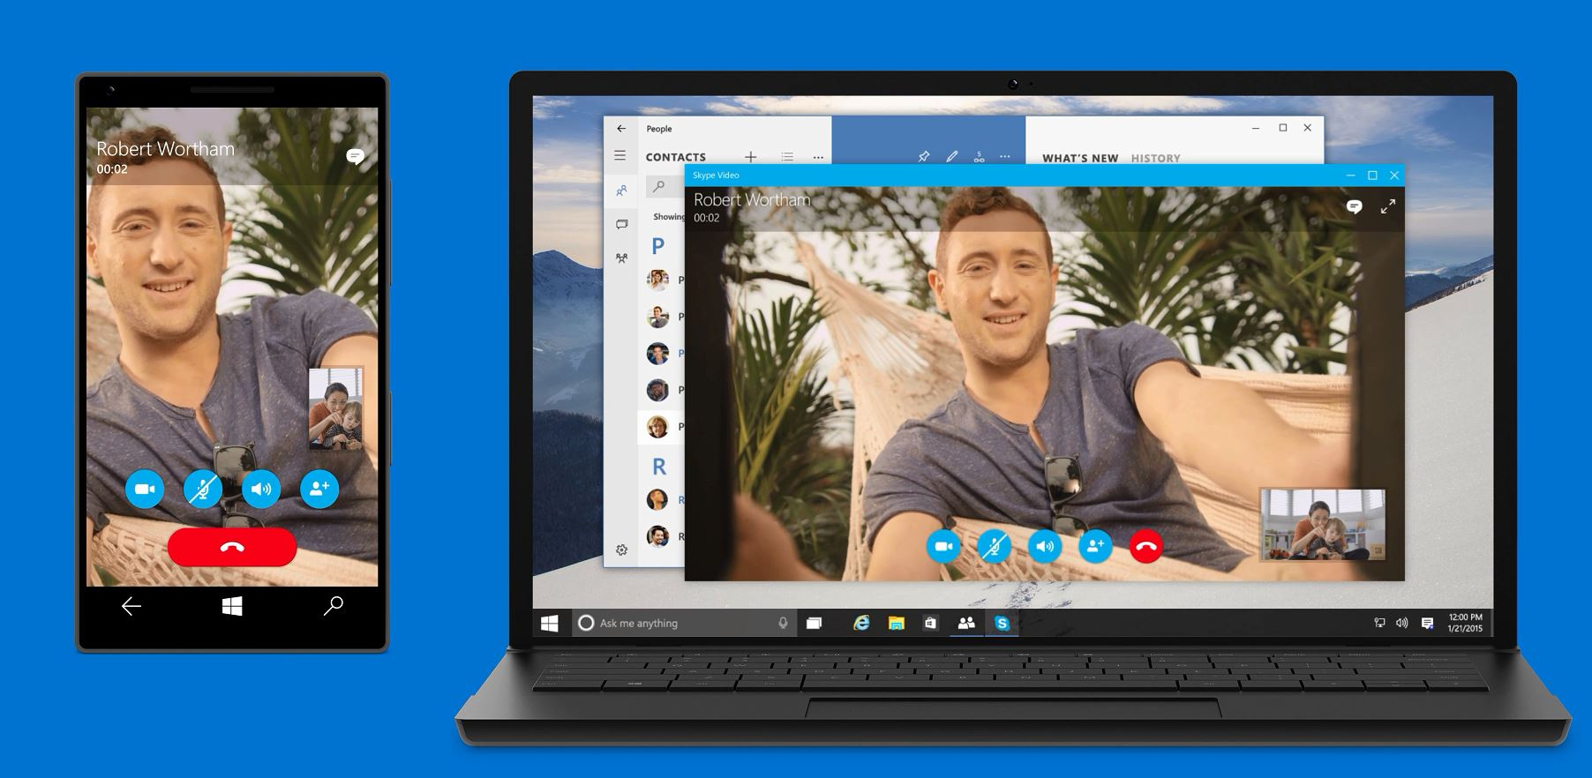
Adaptive design
Tablet (landscape) / Desktop
Phone (portrait)
Notes:
Here’s an example of an app that used adaptive controls on:
a Phone -- [click to build slide]
a Tablet in portrait -- [click to build slide]
and a PC in landscape
The same elements are present across all three, but the layout has adapted. – [click to build slide]
For example, we can see the command bar across all three screens:
On the phone, space is limited and the command pbar is collapsed to a menu icon on the left to show the commands and a search icon on the right.
On the tablet, there is enough room to show the commands along with a search icon
And on the PC, the coamand bart has enough space to adapt to show all the commands plus a full search box
[next slide]

Slide 24
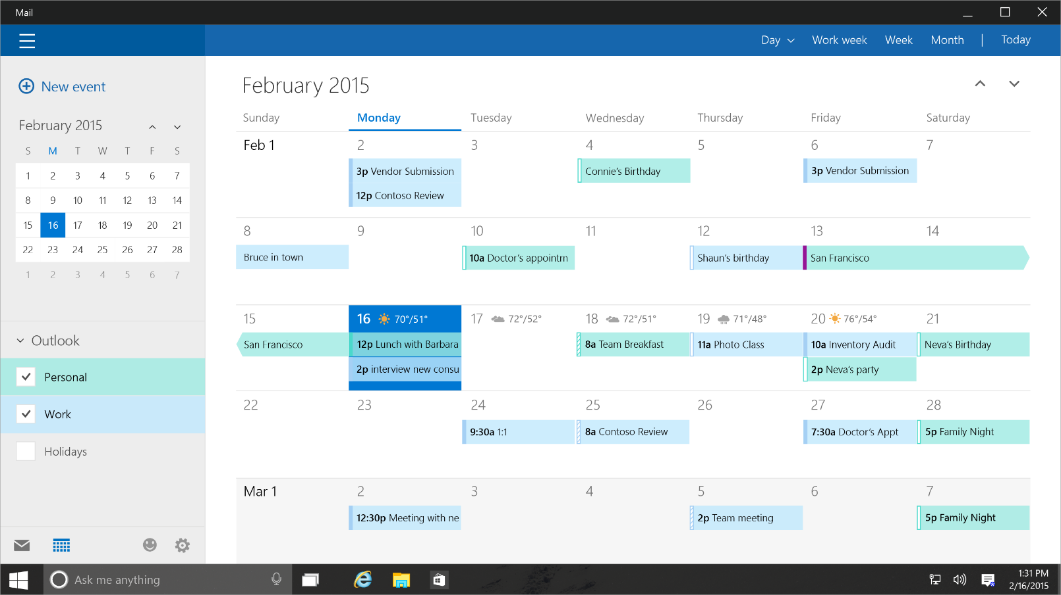
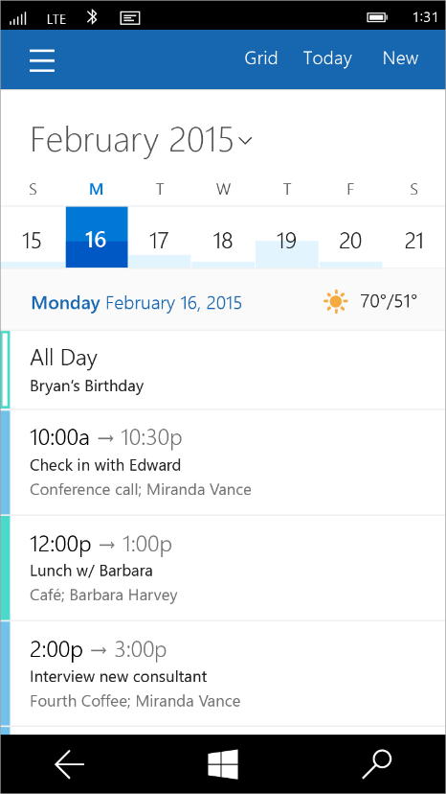
Tailored design
Tablet (landscape) / Desktop
Phone (portrait)
Notes:
Adaptive controls are great, but we know there will be cases where the app designer wants to do something more custom or more tailored than the adaptive controls will allow.
This desire might be motivated by hardware differences. For example, an app that will run on an Xbox might want to create some customizations for navigation using a game controller.
Or it might be motivated by screen size and usability. A designer might want to position a menu at the bottom of a phone screen to make it more usable with a single hand.
For these cases, we enable developers to create what we call a tailored user experience. In this case, the code is the same, but the developer creates custom XAML to deliver the desired design on the right device or in the right set of conditions.
Tailored design goes beyond Adaptive UX
Developers can create custom experiences for certain devices
The code is the same, but custom XAML can deliver the experience a developer wants

Slide 25
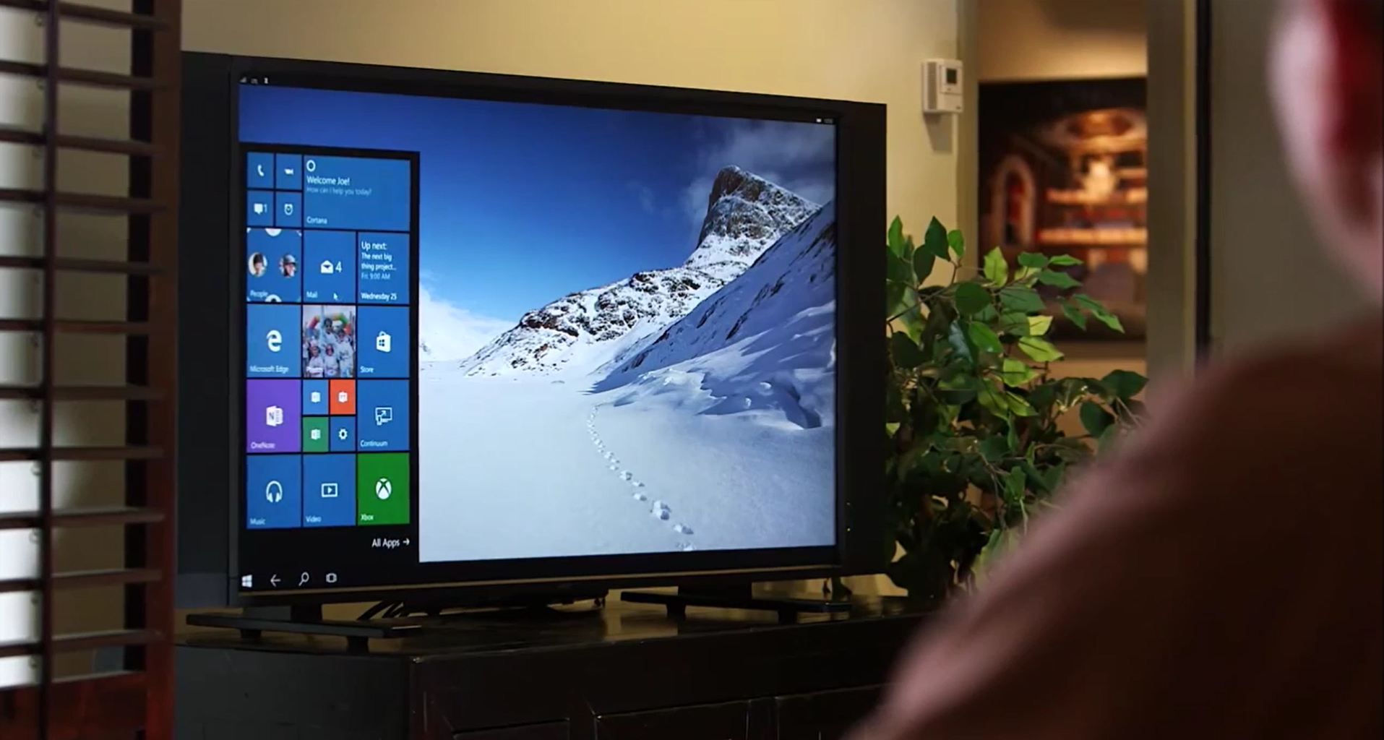
Continuum for Convertibles and Phones
Continuum for convertibles and Phones

Slide 26
Users love apps that give a great experience on all their devices

Slide 27
Demo: Adaptive UI

Slide 28
Adaptive code

Slide 29
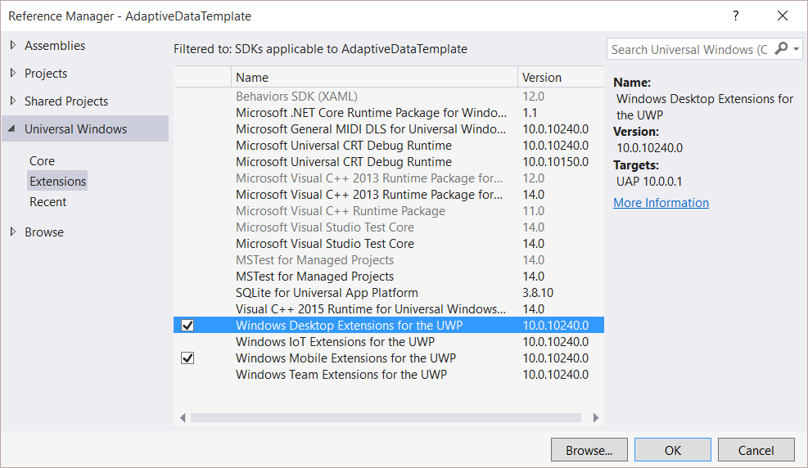
Platform extensions
Device-specific API
Family-specific capabilities
Compatible across devices
Unique update cadence
Windows App
Desktop
extension
Phone
extension
Xbox
extension
Universal Windows Platform
Windows Core
Desktop
Device
Phone
Device
Xbox
Device

Slide 30
Platform extensions don't invalidate binaries on other devices

Slide 31
UWP
UWP
UWP
UWP
Windows Core
Windows Core
Windows Core
Windows Core
Desktop
Mobile
Xbox
More…

Slide 32
Test capabilities at runtime
Use Adaptive Code to light-up our app with capabilities on specific device families
Testing for capabilities and namespaces
var api = "Windows.Phone.UI.Input.HardwareButtons";
if (Windows.Foundation.Metadata.ApiInformation.IsTypePresent(api))
{
Windows.Phone.UI.Input.HardwareButtons.CameraPressed += CameraButtonPressed;
}

Slide 33
Demo: Adaptive code

Slide 34
Microsoft Edge and Web Platform

Slide 35

Microsoft EdgeHTML
Microsoft Edge
.NET & Win32
Android
iOS
JS Symbols
ES6 Numbers Built-Ins
DOM L3 XPath
Rest parameters
4200+ interoperability improvements
ES6 Template Strings
Arrow function
asm.js
JS iterators
<img srcset>
Web Audio API
ES6 classes
GamePad API
Content Security Policy
Video tracks
ES6 Promises
Selection API
ES6 Math Built-Ins
HTTP Strict Transport Security
Touch Events
Media Queries L4 Interaction Media
ES6 String Built-Ins
ES6 WeakSet
getUserMedia()
ES6 Spread
preserve-3d
ES6 Proxies
ES6 Object Built-Ins
HTTP/2
WAV audio
HTTP Live Streaming
Date <input> types
Motion JPEG
Generators
Notes:
Windows 10 has a lot to offer web developers, as well !
First, there’s a new web rendering engine – Microsoft EdgeHTML – that’s built for the modern web.
<click>
It powers both the new Microsoft Edge browser as well as web content in Universal Windows apps.
<click>
Edge leaves behind all of the Internet Explorer specific behaviors that had been built up over the last 20 years
And has over 4,200 interoperability improvements to ensure that the web just works.
For developers, this means less time fixing up your web apps to work across browsers.
EdgeHTML also features over 45 new web standards, including:
HTTP/2
Web Audio
And a bunch more that you can see here.

Slide 36
Microsoft Edge
.NET & Win32
Android
iOS
Notes:
While improving interoperability and adding new features to EdgeHTML, we didn’t forget to pay attention to performance.
Here is how EdgeHTML performs on two leading web benchmarks:
<click>
On the JetStream benchmark created by Apple, which simulates complex web applications, EdgeHTML is over 1.5x faster than IE11.
<click>
Beyond that, it is also ahead of the latest 64-bit browsers.

Slide 37
Microsoft Edge
.NET & Win32
Android
iOS
Notes:
Next on the Octane benchmark, created by Google, Edge is over twice as fast as IE11
<click>
And again, Edge, leapfrogs into the lead ahead of other 64-bit browsers.
Our work is not done, but we feel great that Edge will provide industry leading performance out of the gate.

Slide 38
Bridging Technologies

Slide 39
Web Apps
.NET & Win32
Android
iOS
pp
NEW: Hosted Web Apps
Bring your website experience to the Windows Store
Leverage your web investments and developer workflow
Full access to Universal APIs, including
Tiles, Notifications, Camera, Contact List, Calendar
.appx
HTML
CSS
JS
Universal Windows Platform
Notes:
Beyond making the web run great in the browser itself, Windows 10 provides a powerful new path for sites to become apps.
<click>
With Windows 10, you can re-use your existing web site code and create an app that points directly to your URL.
You don’t need to re-write your server code into packaged client code!
<click>
You can access Universal Windows Platform APIs directly from the web code that came down from your server.
<click>
And you can distribute the app you’ve made in the Windows Store.
This new path is fully integrated into your existing web workflow.
You can continue to use the same tools, libraries, and services you use today.
You can continue to deploy to your servers to make updates.

Slide 40
Demo Microsoft Edge, Hosted web apps

Slide 41
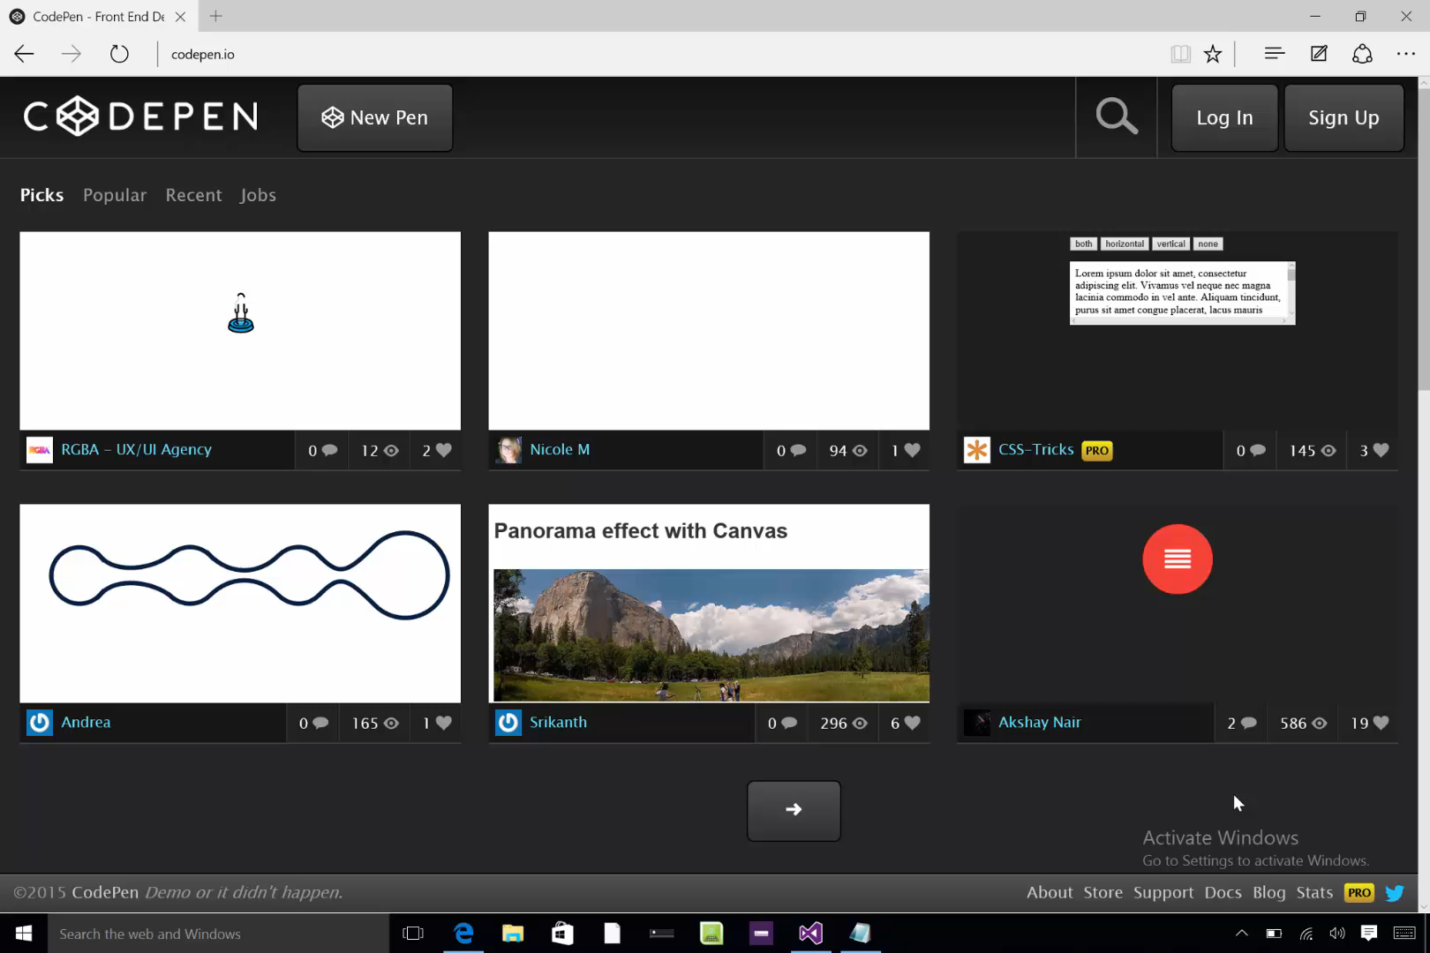

Slide 42
Windows Bridge for Android (a.k.a. Project Astoria)
Tooling to allow apps written for Android™ to run on Windows 10 Mobile with few changes required
Microsoft Interoperability library redirects calls to Google services to Microsoft services
Submit .apk to the Store
Extend to call subset of UWP APIs
Tiles and Notifications
Sign up for limited developer preview at http://uwp.dev.windows.com/en-US/uwp-bridges/android

Slide 43
Windows Bridge for iOS (previously known as ‘Project Islandwood’)
Build Universal Windows Apps using Objective-C
Import Xcode® projects into Visual Studio
Build and debug your Objective-C code from Visual Studio
Take advantage of great Windows services
Extend your app to take advantage of Universal Windows Platform features
Get the Developer Preview:
https://dev.windows.com/en-us/uwp-bridges/ios
Code is open source:
https://github.com/Microsoft/WinObjC/
Notes:
Why the bridge is not a port:
Our goal with the iOS bridge has never been simply to run iOS apps on Windows. Rather, our goal is to help you write great Windows apps that use as much of your existing code and knowledge as possible. We will, of course, continue to work to expand our iOS compatibility, but it’s important to note that there is much more you can do with the bridge.
Behind this goal are three core principles that drove the architecture and design of the bridge:
1.Full Windows API access: Making it easy to use Windows APIs within Objective-C code
2.iOS compatibility: Empower developers to reuse as much existing iOS code as reasonably possible
3.No sandboxing: iOS and Windows APIs should be able to work together

Slide 44
Project Centennial
Package and publish existing .NET and Win32-based Windows applications to the Windows Store
Use Centennial to call common UWP APIs and services
More information coming soon…

Slide 45
Development tools

Slide 46
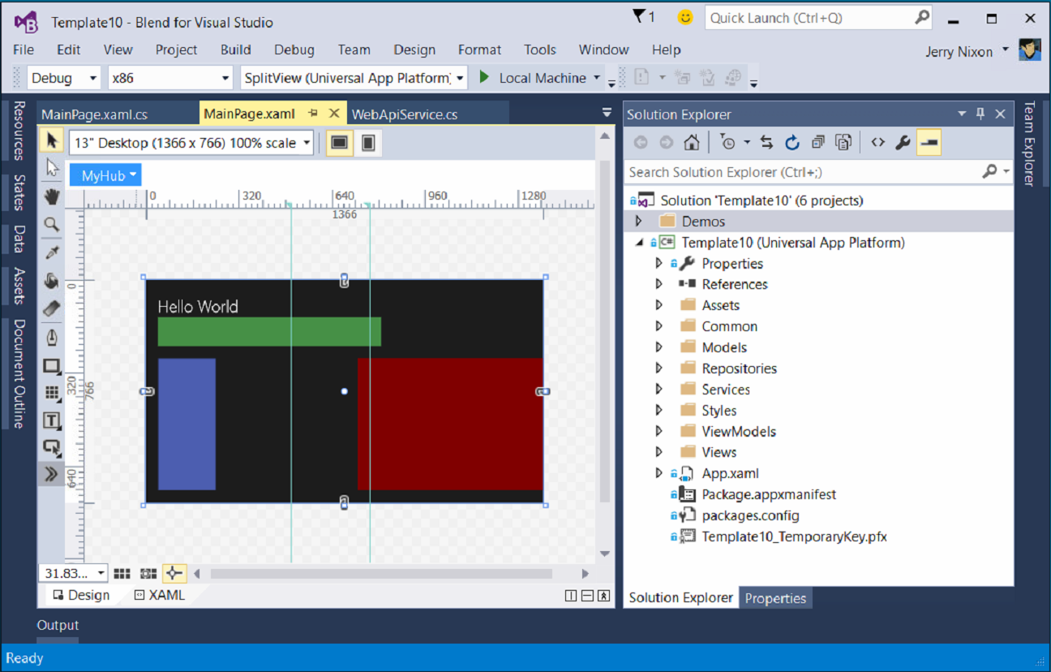
Blend for Visual Studio
The XAML Developer’s IDE
Uses the Visual Studio shell
Full auto-complete & intellisense
Validation
Snippets
Peek
File & solution management
Resource management
Data management
Animation
States

Slide 47
Visual Studio 2015 Editions
Enterprise
Architecture Modeling, Diagnostics, VSO/ALM & Release Management
Professional
Architecture Validation, VSO/ALM & Feedback Management
Community Editions
Visual Studio Professional Edition

Slide 48
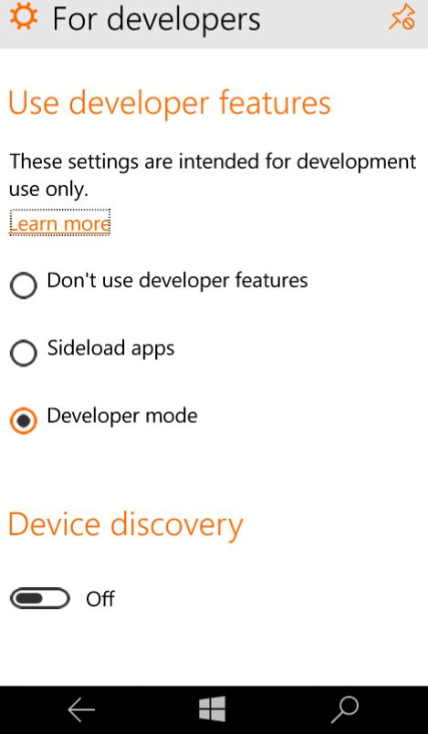
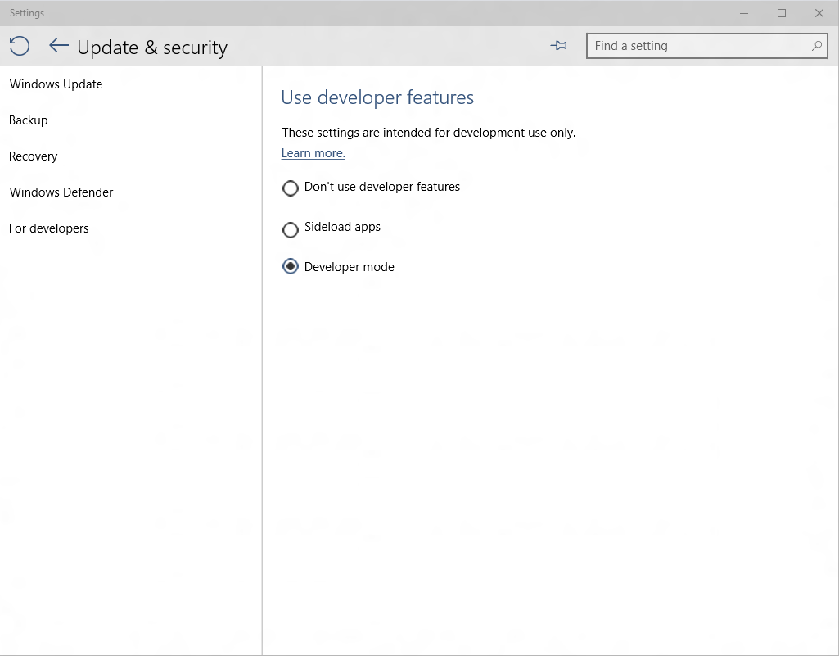
Developer unlock

Slide 49

Where can I develop?
Windows 10
Requires Visual Studio 2015
Windows 8.1 & Windows Server 2012 R2
The Visual Studio designer does not function
Debugging requires a Windows 10 device or Remote Debugging Tools

Slide 50
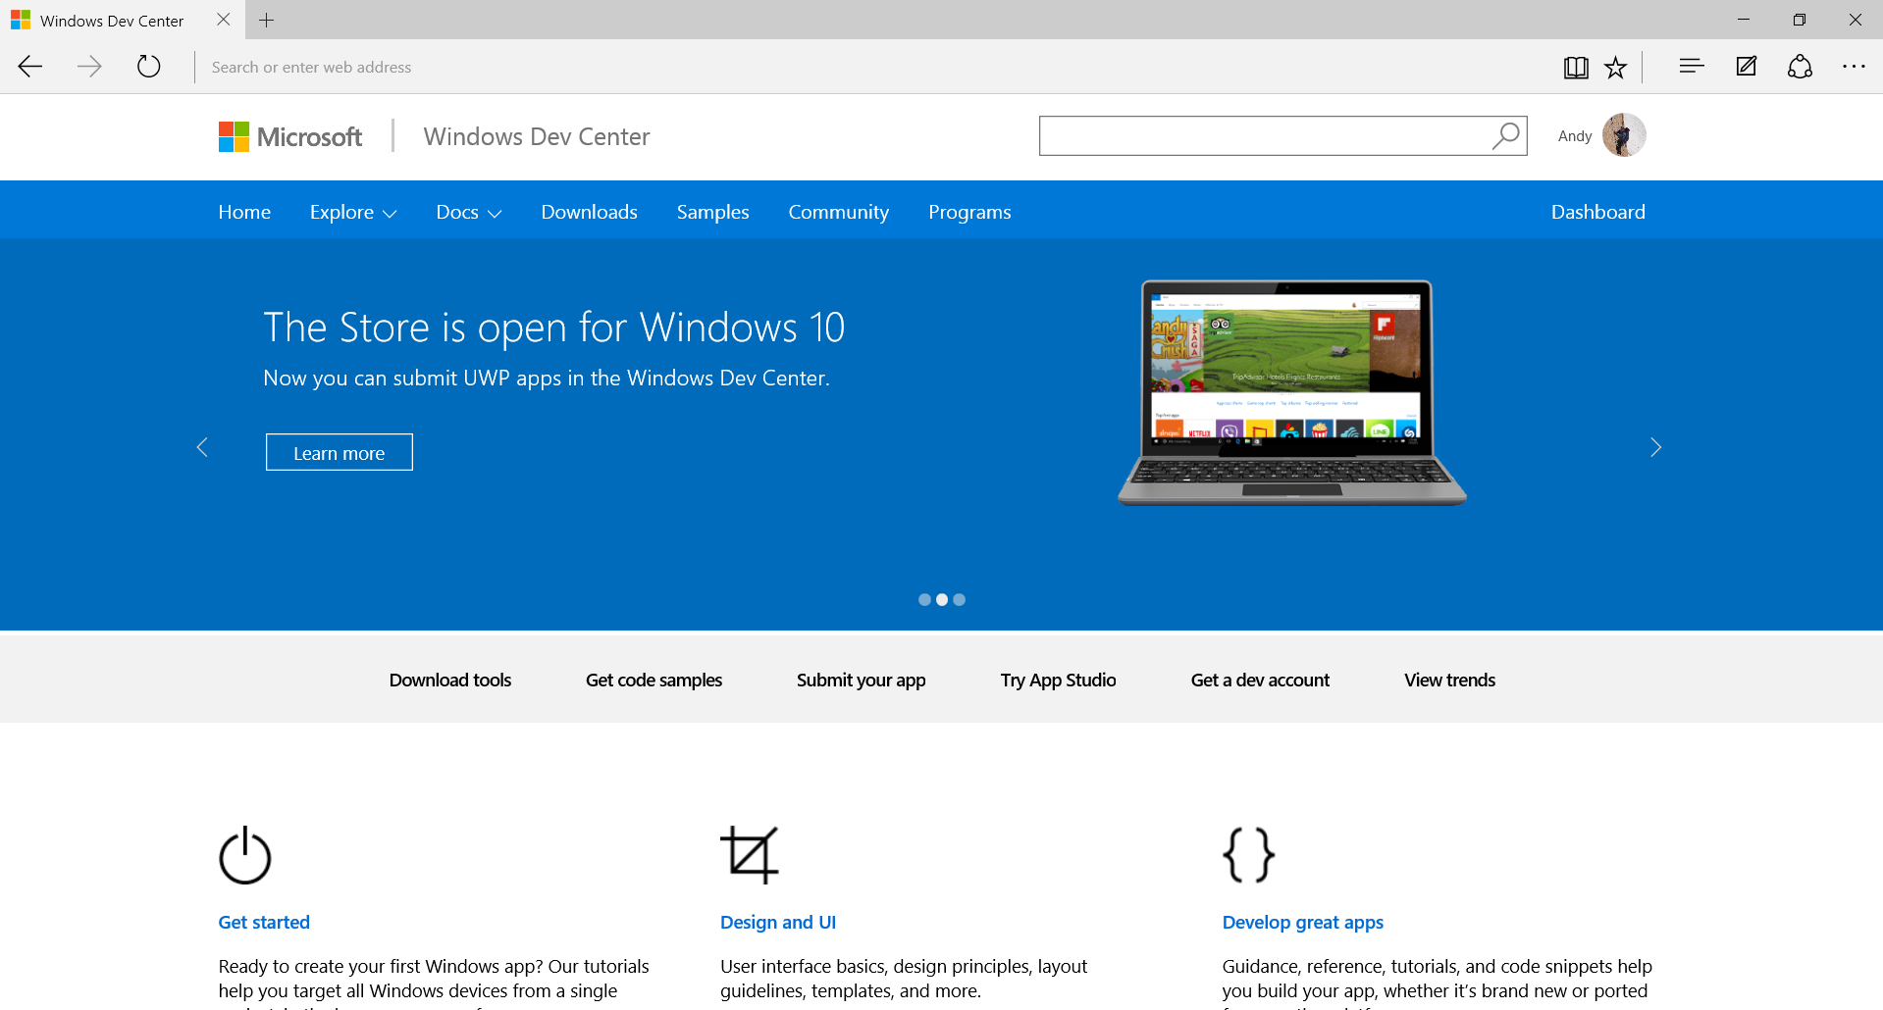
dev.windows.com

